Slide 1
The static Keyword
CS217 – Object Oriented Programming

Slide 2
5.4 Static components

Slide 3
5.4.1 The “auto” keyword (1)
The “auto” keyword came from the ancestor of “C++”, the “C” programming language.
All the variables in your code belong to one of two categories. They are:
automatic variables, created and destroyed automatically during program execution
static variables, existing continuously during the whole program execution
The “C” and “C++” programming languages assume that all variables are automatic by default unless they are declared explicitly as static.

Slide 4
5.4.1 The “auto” keyword (1)
It’s interesting that the “auto” keyword is still commonly used in older versions of the “C” language to explicitly mark automatic variables.
#include <iostream>
using namespace std;
void fun(void) {
auto int var = 99;
cout << "var = " << ++var << endl;
}
int main(void) {
for(int i = 0; i < 5; i++) fun();
return 0;
}
Output:
var = 100
var = 100
var = 100
var = 100
var = 100

Slide 5
5.4.1 The “auto” keyword (1)
The var variable is declared inside the fun function and is automatic.
We’ve used the “auto” keyword, but the program behavior will remain the same if you remove the keyword (try it yourself).
The variable is created each time the fun function is invoked and the variable is destroyed each time the function completes its execution.
This means that, regardless of the number of invocations, the function will always produce the same output.

Slide 6
5.4.2 The “auto” keyword (2)
Now, replace the “auto” keyword with “static”.
The code looks nearly identical, but its behavior has been changed radically.
#include <iostream>
using namespace std;
void fun(void) {
static int var = 99;
cout << "var = " << ++var << endl;
}
int main(void) {
for(int i = 0; i < 5; i++) fun();
return 0;
}
Output:
var = 100
var = 101
var = 102
var = 103
var = 104

Slide 7
5.4.3 Instances of the class
The class is like a dummy be brought to life when its incarnation (in this case its object) is created.
Every object created from a particular class is named a class’s instance.
From this point of view, each instance of the class is a separate universe and has nothing to do with any of the remaining instances.
All the object’s components (fields and functions) are enclosed inside the instance.

Slide 8
5.4.3 Instances of the class
In consequence, we mustn’t use any of the class components until we’ve created an object of that class.
The following snippet is wrong and will cause a compilation error.
#include <iostream>
using namespace std;
class Class {
public:
int val;
void print(void) { cout << val << endl; }
};
int main(void) {
Class::val = 0; //Error
Class::print(); //Error
return 0;
}

Slide 9
5.4.4 Static components of the class
All the rules on the previous slide are true if they refer to the non-static components of the class (both fields and functions).
The “C++” language allows us to define other kinds of components too, they’re called “static components”.
A static component exists throughout the whole life of the program.
Moreover, there is always only one component regardless of the number of instances of the class.
We can say that all the instances share the same static components.

Slide 10
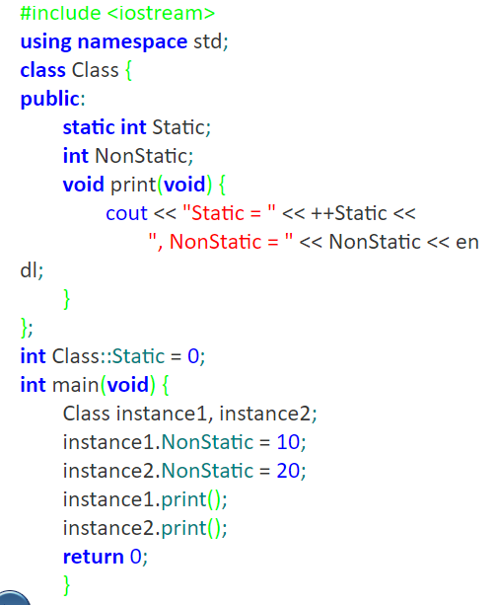
5.4.4 Static components of the class
Output:
Static = 1, NonStatic = 10
Static = 2, NonStatic = 20

Slide 11
5.4.4 Static components of the class
The static variable has to have both
an explicitly expressed separate definition
a possible initialization, and both must be placed outside the class definition.
Another rationale says that the definition has to be separate from the class body because static variables are not actually part of any object.
In our program, we do this with a line of the code between the Class body and the main function.
Removing this line generates an error.

Slide 12
5.4.5 Static class variables (1)
The static class variables usually used as counters of instances of a particular class.
The next program implements this idea in a very simple way.
We’ll increment the static variable Counter inside the Class constructor and decrement it inside the Class destructor
Note once again that the Counter field is accessed directly when it’s being used inside the class and with the “::” operator when it’s being used outside the class.

Slide 13
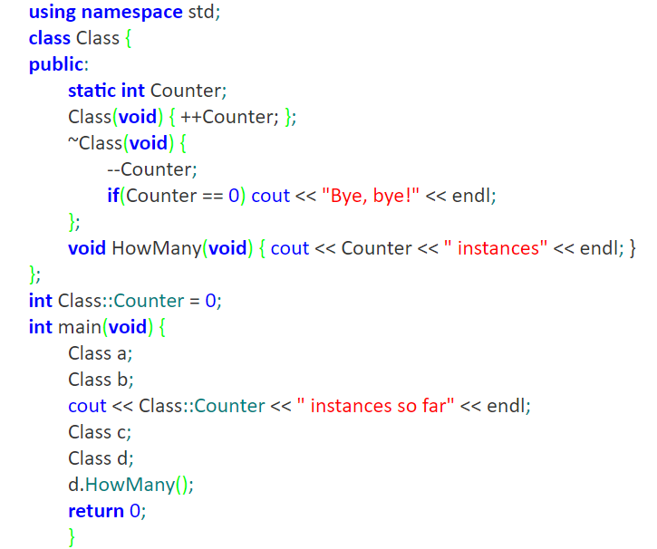
5.4.5 Static class variables (1)
Output:
2 instances so far
4 instances
Bye, bye!
Notes:
using namespace std;
class Class {
public:
static int Counter;
Class(void) { ++Counter; };
~Class(void) {
--Counter;
if(Counter == 0) cout << "Bye, bye!" << endl;
};
void HowMany(void) { cout << Counter << " instances" << endl; }
};
int Class::Counter = 0;
int main(void) {
Class a;
Class b;
cout << Class::Counter << " instances so far" << endl;
Class c;
Class d;
d.HowMany();
return 0;
}

Slide 14
5.4.6 Static class variables (2)
Static variable can be defined private in the class
This will obviously prevent direct access to the variable, but it may be something we want if we want to protect the value against any unauthorized modification.
Note that any attempts to access the Counter variable expressed like this:
Class::Counter = 1;
are strictly prohibited.

Slide 15
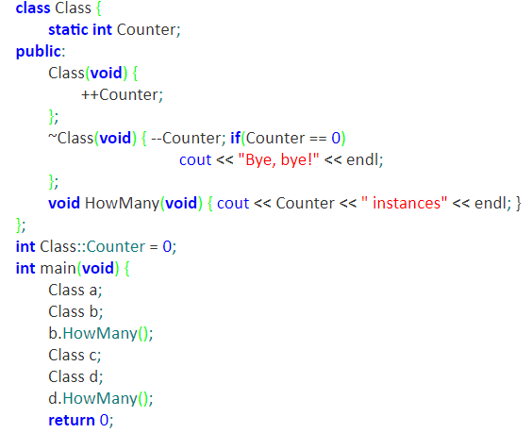
5.4.6 Static class variables (2)
Output:
2 instances
4 instances
Bye, bye!

Slide 16
5.4.7 Static class functions
It’s not only class variables that can be declared as static – functions can be declared like this, too.
The static function, like a static variable, may also be accessed (or more precisely, invoked) when no instances of the class have been created.
Note that the static function may be invoked from inside the class, like this:
Class::HowMany();
or by using any of the existing instances, like this:
b.HowMany();

Slide 17
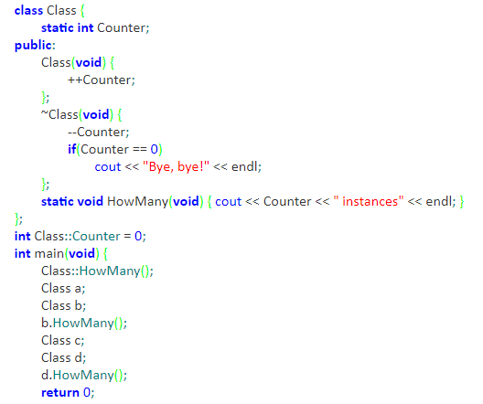
5.4.7 Static class functions
Output:
0 instances
2 instances
4 instances
Bye, bye!

Slide 18
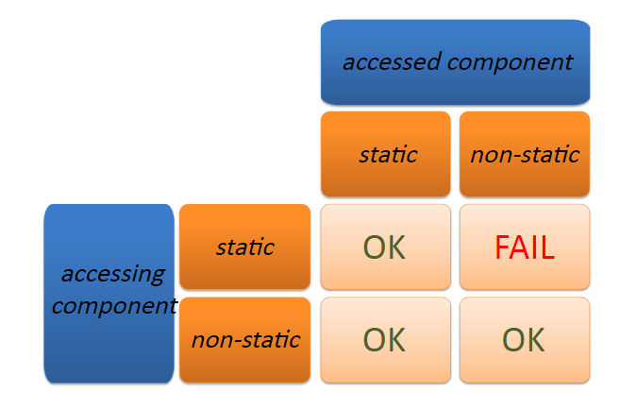
5.4.8 Static vs. non-static components
The coexistence of both static and non-static components within a single class causes some additional issues which we need to take into consideration.

Slide 19
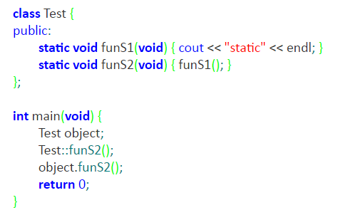
5.4.9 Static → static interaction
The first test program demonstrates a case when a static function tries to invoke another static function.
A case like this is always possible, as both functions are available during the entire life of the program.
Output:
static
static

Slide 20
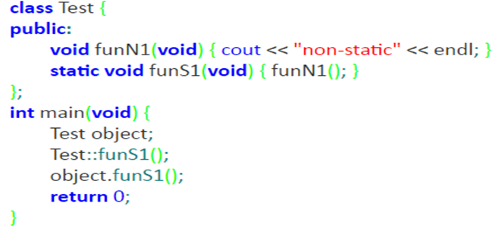
5.4.11 Static → non-static interaction
The second test program demonstrates a case when a static function tries to invoke a non-static function.
A case like this is not possible, as the function being invoked exists when and only when any of the objects which contain this function also exists. The function cannot be successfully accessed without specifying the associated object.
Syntax Error
Static member can’t invoke non-static member

Slide 21
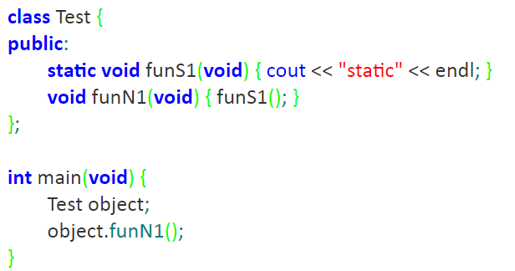
5.4.13 Non-static → static interaction
The third test case refers to the situation where a non-static function invokes a static function.
A case like this is always possible, as the static function is available before any object has been created.
Output:
static

Slide 22
5.4.15 Static vs. non-static components
The last remaining option is simple. We don’t need to do any experiment to find out the answer to the following question:
Is it possible to invoke a non-static function from within a non-static function?
Yes, obviously it is possible. What’s more, we’ve done it many times before.

